Slide 1
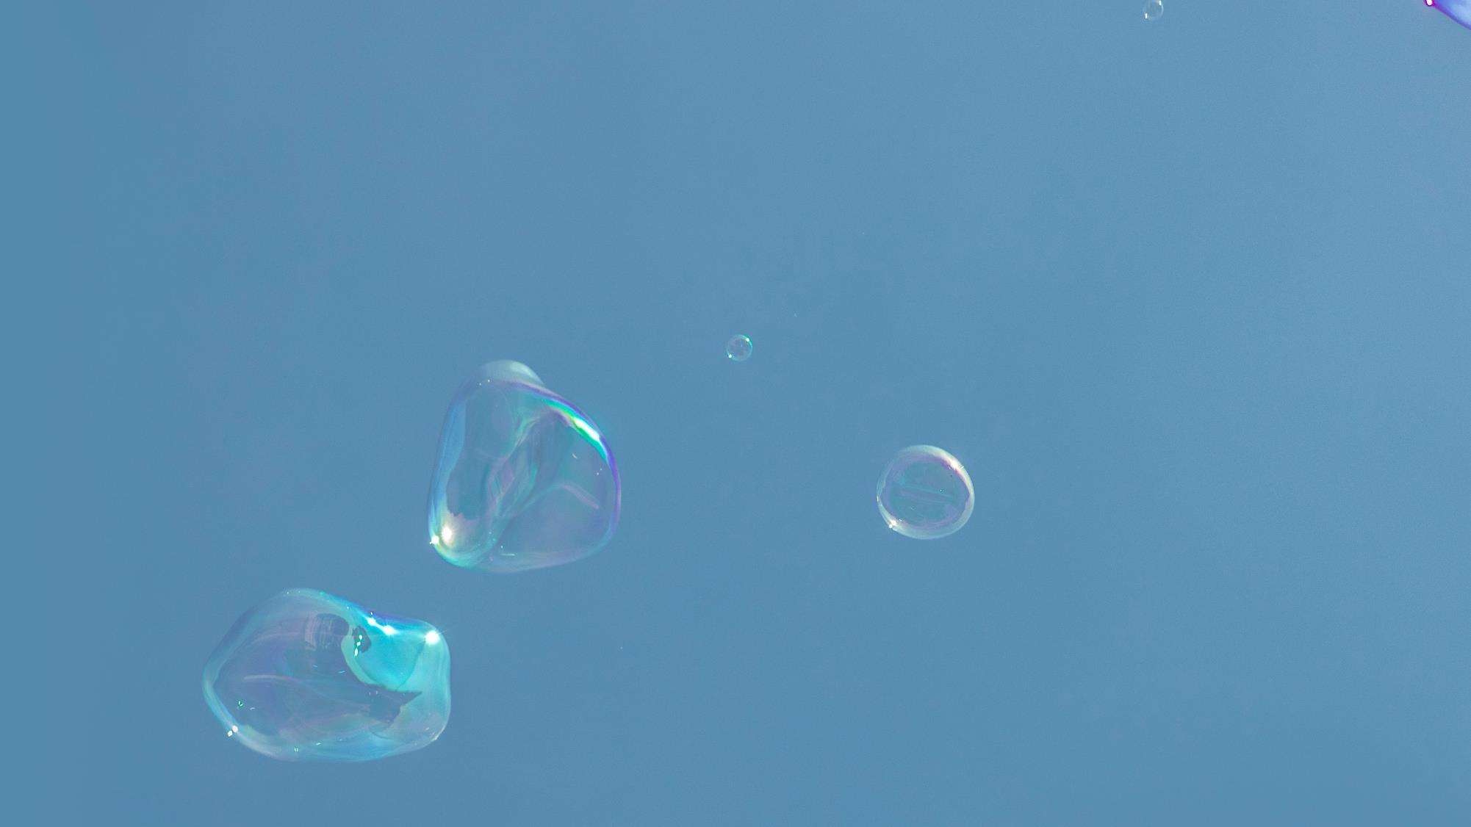
Project.
GUI환경에서 동영상 편집
ⓒSaebyeol Yu. Saebyeol’s PowerPoint

Slide 2
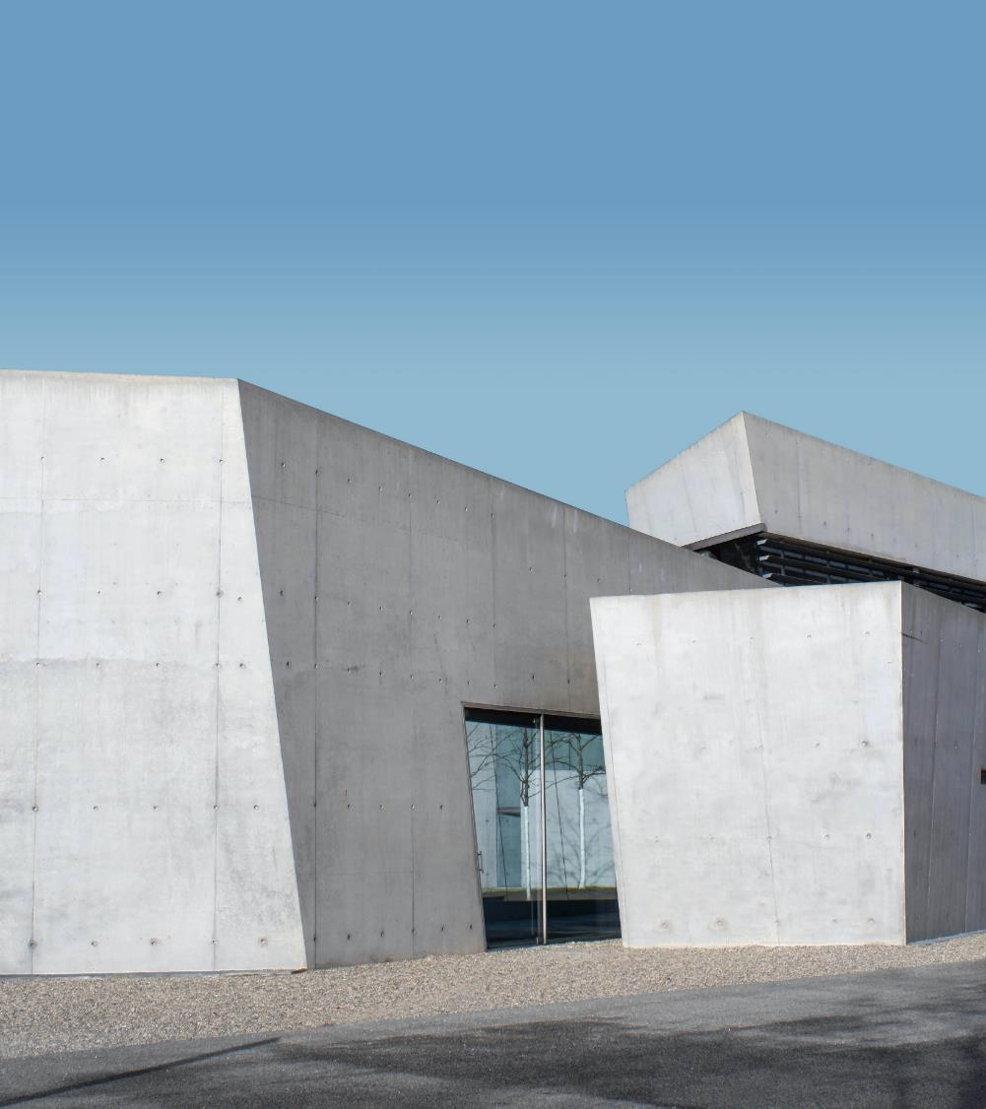
목차
a table of contents
1
프로그램 개요
2
제작
3
결과
4
개선 사항
ⓒSaebyeol Yu. Saebyeol’s PowerPoint

Slide 3
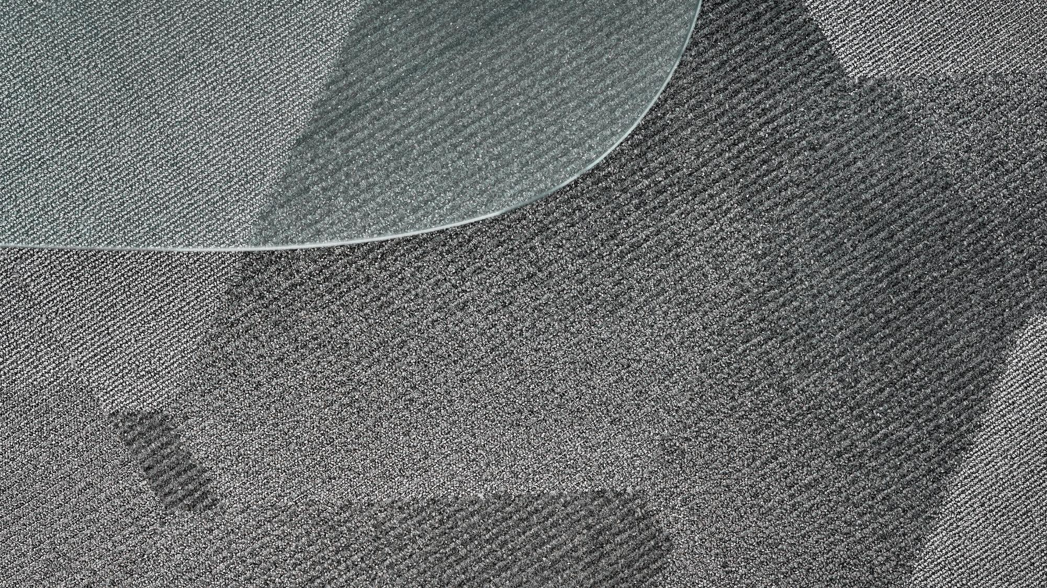
Part 1
프로그램 개요
ⓒSaebyeol Yu. Saebyeol’s PowerPoint

Slide 4
Part 2
구현 기능
이진화
적용된 프레임 저장
동영상 불러오기
적용된 영상 출력

Slide 5
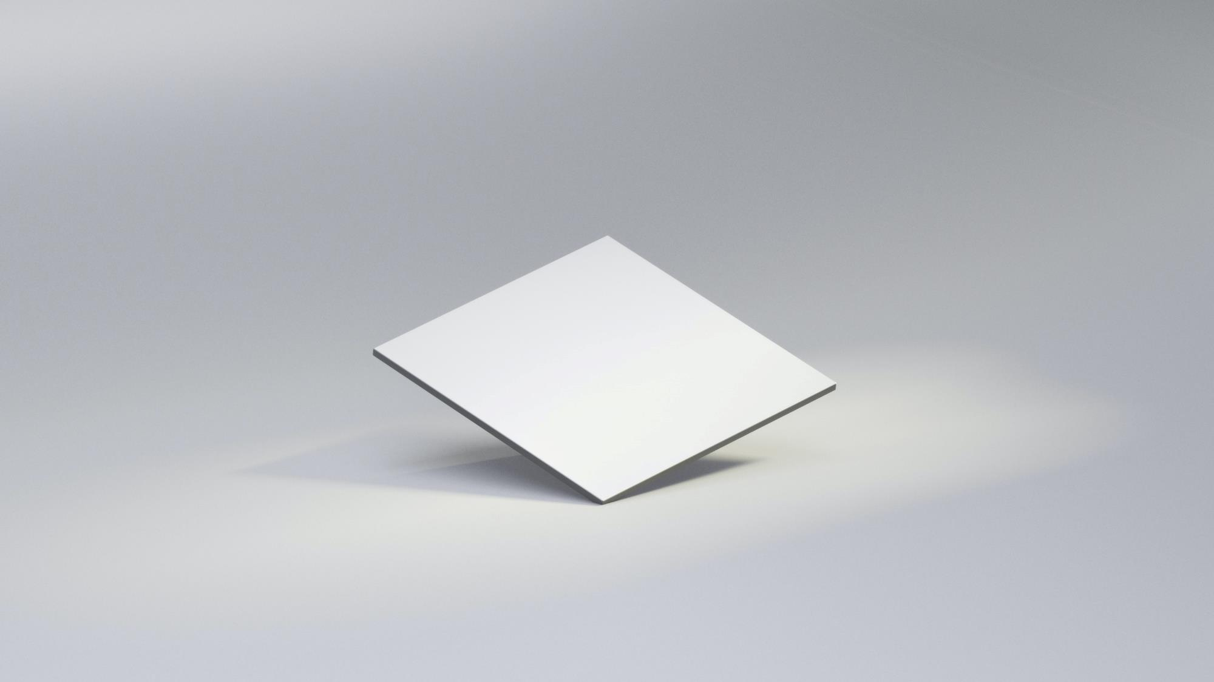
Part 2
제작

Slide 6
Part 2
제작
작성 언어
Python
프로그램은 파이썬을 통해 작성하였으며, 개발 환경으로는 파이참을 사용하였다.
GUI
Qt designer
Sample data
sample
X-Ray 사진과 환자 정보는 Qt Designer로 제작한 UI에 출력하였다.
임의의 저장된 동영상 사용

Slide 7
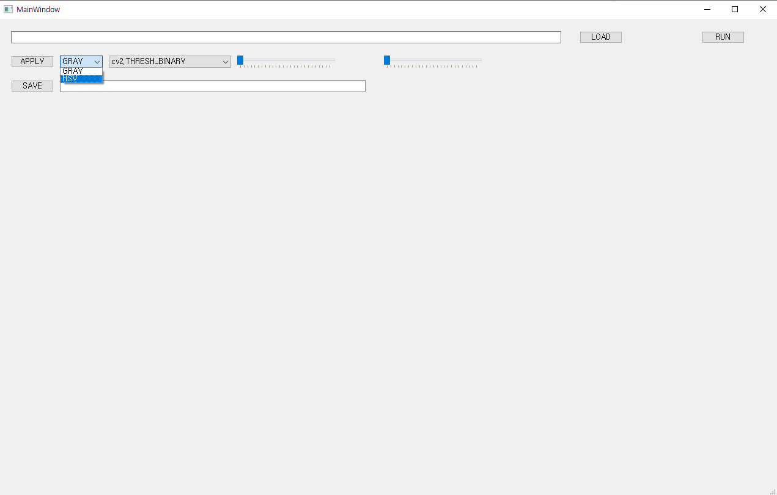
Part 2
구현 기능
Image scale
scale 설정

Slide 8
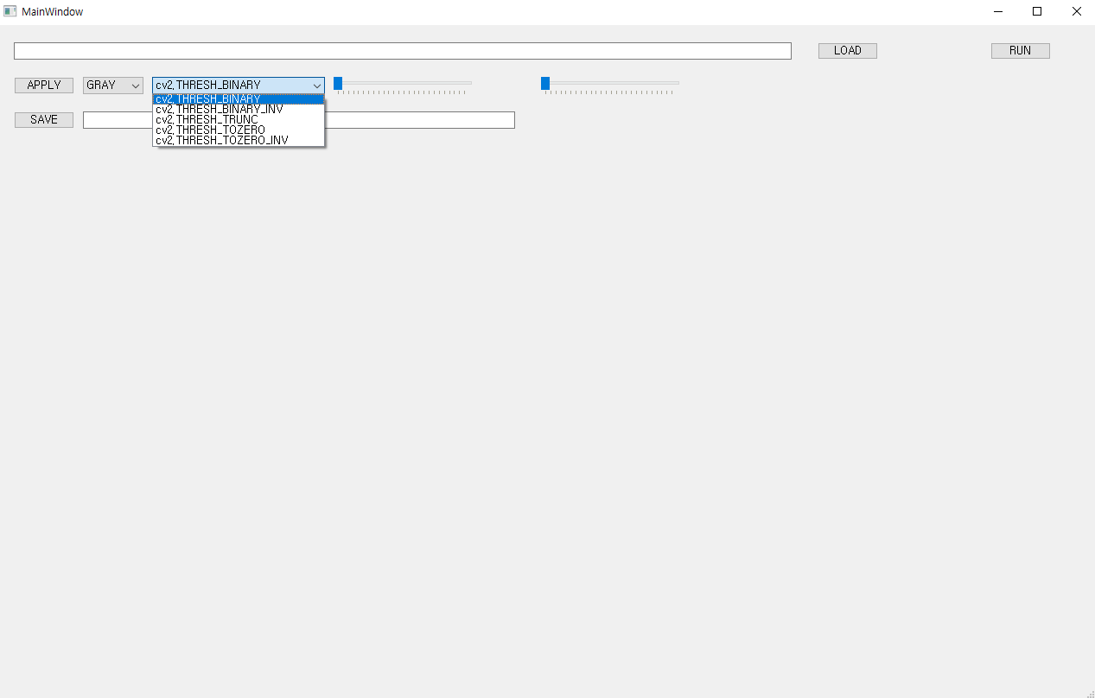
Part 2
구현 기능
옵션
GRAY scale
cv2.threshold 옵션 설정 가능
HSV scale
h, s, v 중 하나의 채널 값을 masking

Slide 9
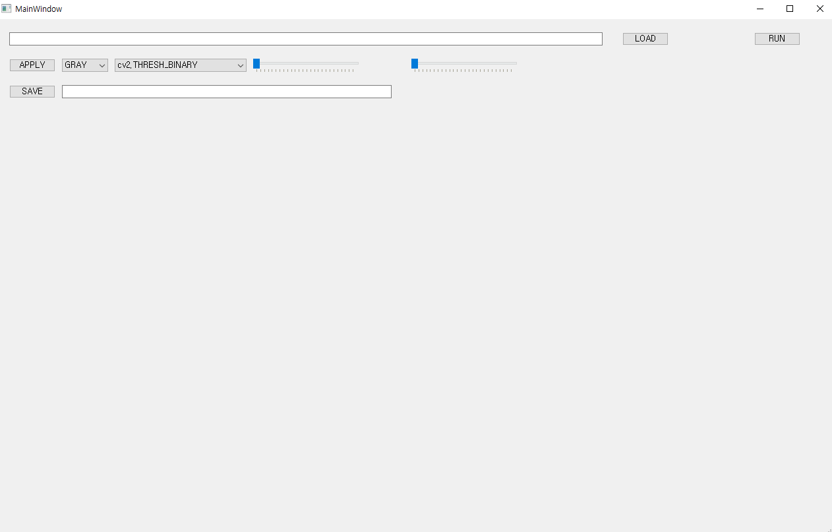
Part 2
구현 기능
편집한 프레임 저장

Slide 10
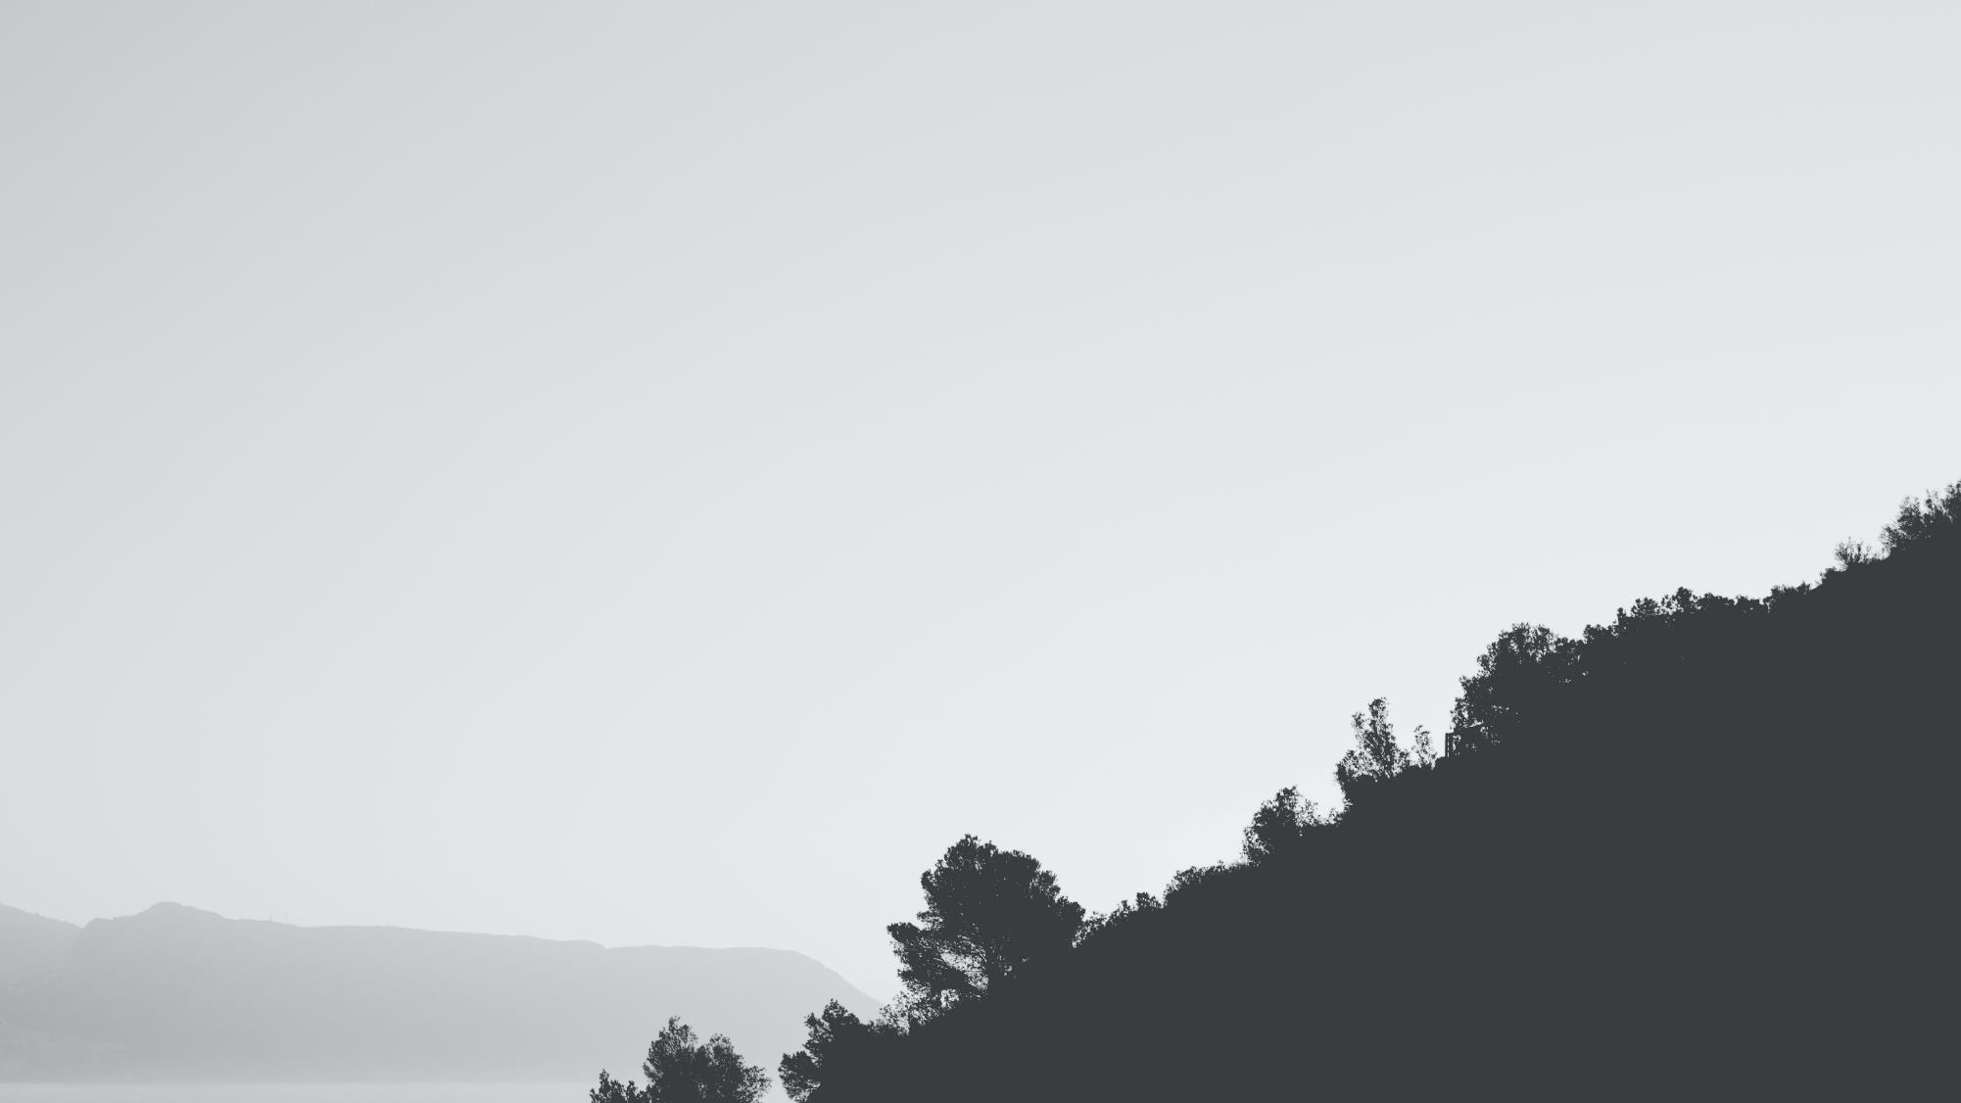
Part 3
결과
ⓒSaebyeol Yu. Saebyeol’s PowerPoint

Slide 11
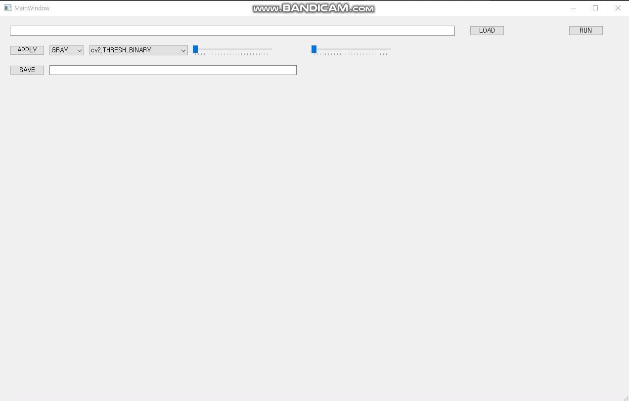
Part 3
프로그램 작동 영상

Slide 12
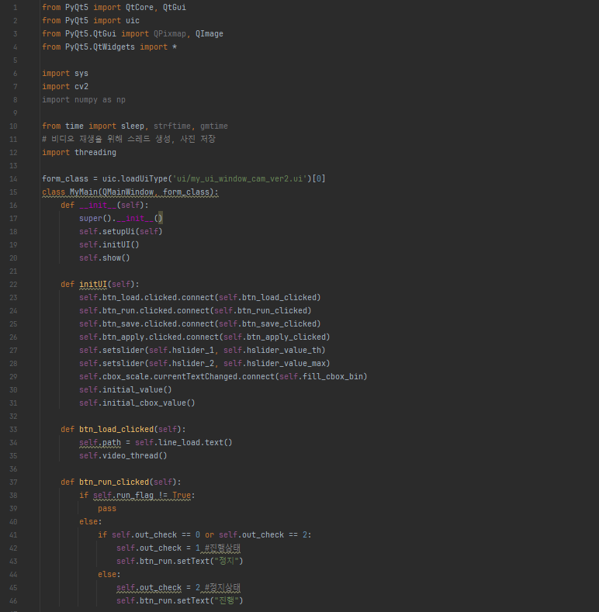
Part 3
코드
전문은 슬라이드 노트에서 확인 가능
Notes:
from PyQt5 import QtCore, QtGui from PyQt5 import uic from PyQt5.QtGui import QPixmap, QImage from PyQt5.QtWidgets import * import sys import cv2 import numpy as np from time import sleep, strftime, gmtime # 비디오 재생을 위해 스레드 생성, 사진 저장 import threading form_class = uic.loadUiType('ui/my_ui_window_cam_ver2.ui')[0] class MyMain(QMainWindow, form_class): def __init__(self): super().__init__() self.setupUi(self) self.initUI() self.show() def initUI(self): self.btn_load.clicked.connect(self.btn_load_clicked) self.btn_run.clicked.connect(self.btn_run_clicked) self.btn_save.clicked.connect(self.btn_save_clicked) self.btn_apply.clicked.connect(self.btn_apply_clicked) self.setslider(self.hslider_1, self.hslider_value_th) self.setslider(self.hslider_2, self.hslider_value_max) self.cbox_scale.currentTextChanged.connect(self.fill_cbox_bin) self.initial_value() self.initial_cbox_value() def btn_load_clicked(self): self.path = self.line_load.text() self.video_thread() def btn_run_clicked(self): if self.run_flag != True: pass else: if self.out_check == 0 or self.out_check == 2: self.out_check = 1 #진행상태 self.btn_run.setText("정지") else: self.out_check = 2 #정지상태 self.btn_run.setText("진행") def initial_value(self): self.save_count = 0 #btn_save_clicked, save 횟수 self.hslider_v = 127 #setslider, self.hslider_1.Value의 초기값 self.hslider_m = 255 #setslider, self.hslider_2.value의 초기값 self.run_flag = False #flag, video_thread 시작 self.out_check = 0 # btn_run_clicked, flag, lbl_dst 출력중 = 1, 중지 = 2 def initial_cbox_value(self): self.binary = ['cv2.THRESH_BINARY', 'cv2.THRESH_BINARY_INV', 'cv2.THRESH_TRUNC', 'cv2.THRESH_TOZERO', 'cv2.THRESH_TOZERO_INV', 'Canny'] # cbox_bin self.HSV = ['H', 'S', 'V'] # cbox_bin self.currentText = 'GRAY' # btn_apply_clicked, currentText = cbox_scale.currentText() self.fill_cbox_bin() self.bin_cur_text = self.cbox_bin.currentText() def setslider(self, slider, sliderfunc): slider.setTickPosition(50) slider.setRange(0, 255) slider.setSingleStep(1) slider.valueChanged.connect(sliderfunc) def hslider_value_th(self, value): self.hslider_1.setValue = value self.hslider_1_v.setText(str(value)) def hslider_value_max(self, value): self.hslider_2.setValue = value self.hslider_2_v.setText(str(value)) def fill_cbox_bin(self): if self.cbox_scale.currentText() == 'GRAY': self.cbox_bin.clear() for i in self.binary: self.cbox_bin.addItem(i) if self.cbox_scale.currentText() == 'HSV': self.cbox_bin.clear() for i in self.HSV: self.cbox_bin.addItem(i) #동영상 실행 ######################################################################################################################## def video_thread(self): self.thread = threading.Thread(target=self.video_to_frame, args=(self,)) self.thread.daemon = True # 프로그램 종료시 프로세스도 함께 종료 (백그라운드 재생 X) self.thread.start() self.run_flag = True def video_to_frame(self, MainWindow): ###cap으로 영상의 프레임을 가지고와서 전처리 후 화면에 띄움### capture = cv2.VideoCapture(self.path) while self.run_flag: self.ret, frame = capture.read() # 영상의 정보 저장 frame = frame[20:, :460, :] self.frame = frame.copy() #line_134 오류 방지위해 .copy() if self.ret: #cut_h_start = 20 #self.frame = self.frame[cut_h_start:self.frame.shape[0], 0:460, :] if self.out_check != 1: self.display_output_image(self.frame, 0) elif self.out_check == 1: self.process_result() self.display_output_image(self.frame, 0) self.display_output_image(self.frame_out, 1) else: break if self.capture.isOpened(): self.capture.release() def process_result(self): if self.currentText == 'GRAY': self.frame2 = self.frame self.frame2 = cv2.GaussianBlur(self.frame2, (5, 5), 3) self.frame_out1 = cv2.cvtColor(self.frame2, cv2.COLOR_BGR2GRAY) self.apply_binary(self.bin_cur_text) elif self.currentText == 'HSV': self.frame2 = self.frame self.frame_out1 = cv2.cvtColor(self.frame2, cv2.COLOR_BGR2HSV) self.apply_hsv(self.bin_cur_text) def display_output_image(self, img_dst, mode): h, w = img_dst.shape[:2] # 그레이영상의 경우 ndim이 2이므로 h,w,ch 형태로 값을 얻어올수 없다 if img_dst.ndim == 2: qImg = QImage(img_dst, w, h, w * 1, QImage.Format_Grayscale8) else: #bytes_per_line = img_dst.shape[2] * h #print(bytes_per_line) qImg = QImage(img_dst, w, h, img_dst.strides[0], QImage.Format_BGR888) self.pixmap = QtGui.QPixmap(qImg) p = self.pixmap.scaled(600, 450, QtCore.Qt.KeepAspectRatio) # 프레임 크기 조정 # p = self.pixmap.scaled(600, 450, QtCore.Qt.IgnoreAspectRatio) # 프레임 크기 조정 if mode == 0: self.lbl_src.setPixmap(p) self.lbl_src.update() # 프레임 띄우기 else: self.lbl_dst.setPixmap(p) self.lbl_dst.update() # 프레임 띄우기 sleep(0.01) # 영상 1프레임당 0.01초로 이걸로 영상 재생속도 조절하면됨 0.02로하면 0.5배속인거임 ######################################################################################################################## #편집 및 저장 ######################################################################################################################## def contour(self,img_proc): contours, hierarchy = cv2.findContours(img_proc, cv2.RETR_EXTERNAL, cv2.CHAIN_APPROX_NONE) count = 0 money = 0 for i, contour in enumerate(contours): # print(f'{i} : {cv2.contourArea(contour)}') area = cv2.contourArea(contour) if area >= 100: count += 1 cv2.drawContours(self.frame, [contour], 0, (0, 255, 0), 2) x, y, w, h = cv2.boundingRect(contour) pt1 = (x, y) pt2 = (x + w, y + h) cv2.rectangle(self.frame, pt1, pt2, (255, 0, 0), 1) #### moment mu = cv2.moments(contour) cX = int(mu['m10'] / (mu['m00']) + 1e-5) cY = int(mu['m01'] / (mu['m00']) + 1e-5) cv2.circle(self.frame, (cX, cY), 5, (255, 255, 255), -1) cv2.putText(self.frame, f'{i}:{area}', (cX - 60, cY + 25), cv2.FONT_HERSHEY_COMPLEX, 0.7, (0, 0, 255), 1) if 3000 < area < 3500: #10원 money += 10 elif 4200 < area < 4800: #50원 money += 50 elif 5200 < area < 5800: #100원 money += 100 elif 6500 < area < 7500: #500원 money += 500 cv2.rectangle(self.frame, (0, 420), (420, 460), (255, 0, 255), -1) cv2.putText(self.frame, f'coins : {count}, money : {money}', (0, 440), cv2.FONT_HERSHEY_COMPLEX, 0.7, (255, 255, 255), 1) def btn_apply_clicked(self): self.hslider_v = self.hslider_1.value() self.hslider_m = self.hslider_2.value() self.currentText = self.cbox_scale.currentText() self.bin_cur_text = self.cbox_bin.currentText() if self.out_check == 2 and self.currentText == 'GRAY': self.process_result() self.display_output_image(self.frame_out, 1) def apply_binary(self, state): if state == 'cv2.THRESH_BINARY': _, self.frame_out = cv2.threshold(self.frame_out1, self.hslider_v, self.hslider_m, cv2.THRESH_BINARY) elif state == 'cv2.THRESH_BINARY_INV': _, self.frame_out = cv2.threshold(self.frame_out1, self.hslider_v, self.hslider_m, cv2.THRESH_BINARY_INV) elif state == 'cv2.THRESH_TRUNC': _, self.frame_out = cv2.threshold(self.frame_out1, self.hslider_v, self.hslider_m, cv2.THRESH_TRUNC) elif state == 'cv2.THRESH_TOZERO': _, self.frame_out = cv2.threshold(self.frame_out1, self.hslider_v, self.hslider_m, cv2.THRESH_TOZERO) elif state == 'cv2.THRESH_TOZERO_INV': _, self.frame_out = cv2.threshold(self.frame_out1, self.hslider_v, self.hslider_m, cv2.THRESH_TOZERO_INV) elif state == 'Canny': frame_out = cv2.Canny(self.frame_out1, self.hslider_v, self.hslider_m) # dialation kernel = cv2.getStructuringElement(cv2.MORPH_RECT, (3, 3)) img_dial = cv2.dilate(frame_out, kernel) self.frame_out = cv2.morphologyEx(img_dial,cv2.MORPH_CLOSE, kernel) self.contour(self.frame_out) def apply_hsv(self, state): if state =='H': if self.hslider_v > 180: self.hslider_v = 180 if self.hslider_m > 180: self.hslider_m = 180 if self.hslider_v <= self.hslider_m: mask = cv2.inRange(self.frame_out1, (self.hslider_v, 0, 0), (self.hslider_m, 255, 255)) hsv = cv2.bitwise_and(self.frame_out1, self.frame_out1, mask=mask) elif self.hslider_v > self.hslider_m: upper_red = cv2.inRange(self.frame_out1, (self.hslider_v, 0, 0), (180, 255, 255)) lower_red = cv2.inRange(self.frame_out1, (0, 0, 0), (self.hslider_m, 255, 255)) added_red = cv2.addWeighted(lower_red, 1.0, upper_red, 1.0, 0.0) hsv = cv2.bitwise_and(self.frame_out1, self.frame_out1, mask=added_red) if state =='S': if self.hslider_v <= self.hslider_m: mask = cv2.inRange(self.frame_out1, (0, self.hslider_v, 0), (180, self.hslider_m, 255)) hsv = cv2.bitwise_and(self.frame_out1, self.frame_out1, mask=mask) if self.hslider_v > self.hslider_m: upper_mask = cv2.inRange(self.frame_out1, (0, self.hslider_v, 0), (180, 255, 255)) lower_mask = cv2.inRange(self.frame_out1, (0, 0, 0), (180, self.hslider_m, 255)) added_mask = cv2.addWeighted(lower_mask, 1.0, upper_mask, 1.0, 0.0) hsv = cv2.bitwise_and(self.frame_out1, self.frame_out1, mask=added_mask) if state =='V': if self.hslider_v <= self.hslider_m: mask = cv2.inRange(self.frame_out1, (0, 0, self.hslider_v), (180, 255, self.hslider_m)) hsv = cv2.bitwise_and(self.frame_out1, self.frame_out1, mask=mask) if self.hslider_v > self.hslider_m: upper_mask = cv2.inRange(self.frame_out1, (0, 0, self.hslider_v), (180, 255, 255)) lower_mask = cv2.inRange(self.frame_out1, (0, 0, 0), (180, 255, self.hslider_m)) added_mask = cv2.addWeighted(lower_mask, 1.0, upper_mask, 1.0, 0.0) hsv = cv2.bitwise_and(self.frame_out1, self.frame_out1, mask=added_mask) self.frame_out = cv2.cvtColor(hsv, cv2.COLOR_HSV2BGR) def btn_save_clicked(self): if self.out_check != 0: self.save_count += 1 file = 'save_images/capture' + str(self.save_count) + '.png' cv2.imwrite(file, self.frame_out) file2 = file + ' saved' self.line_save.setText(file2) ######################################################################################################################## def closeEvent(self, event): reply = QMessageBox.question(self, 'Message', "종료 하시겠습니까?", QMessageBox.Yes | QMessageBox.No, QMessageBox.No) if reply == QMessageBox.Yes: self.run_flag = False # Video_to_frame에 while문에 사용(강제종료시 에러문제) event.accept() else: event.ignore() # def processing_image(self, img_gray, img_src): # # 여기에 이미지 프로세싱을 진행하고 output으로 리턴하면 오른쪽에 결과 영상 출력됨 # # output = img_src.copy() #원본영상 그대로 리턴 # output = img_gray.copy() # 그래이 영상 리턴 # return output if __name__ == '__main__': app = QApplication(sys.argv) window = MyMain() sys.exit(app.exec_())

Slide 13
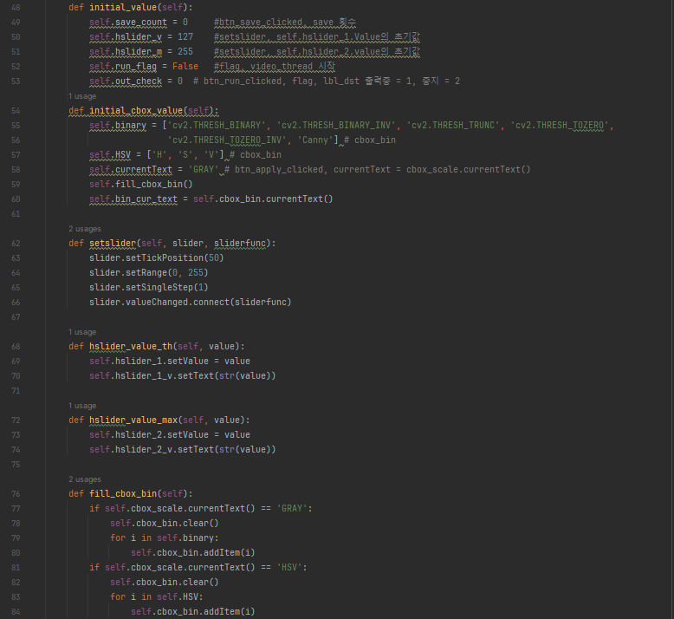
Part 3
코드

Slide 14
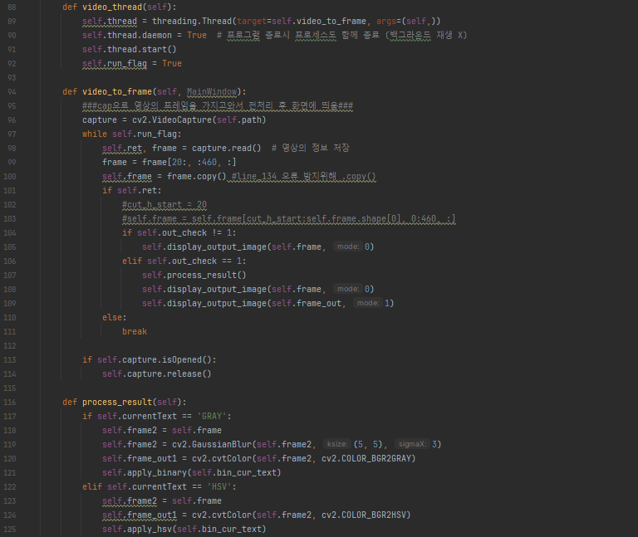
Part 3
코드

Slide 15
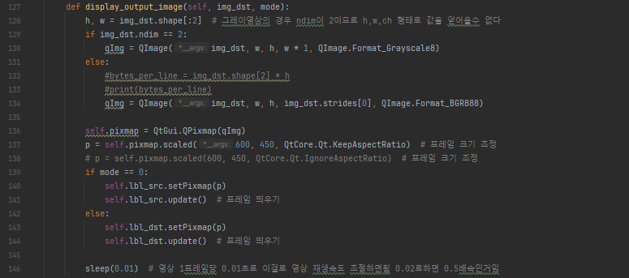
Part 3
코드

Slide 16
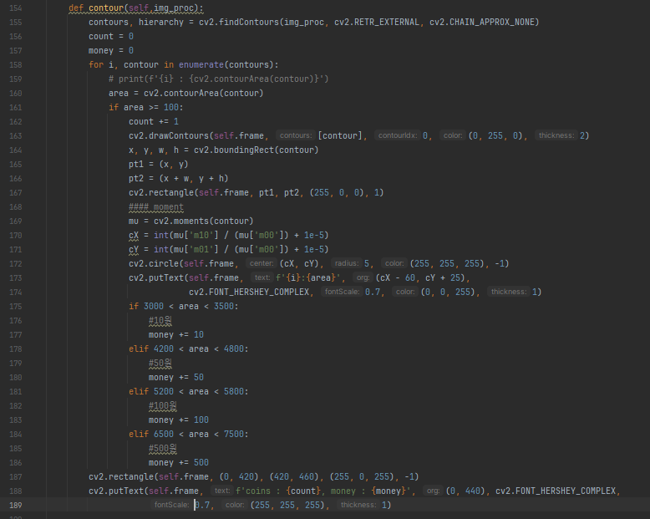
Part 3
코드

Slide 17
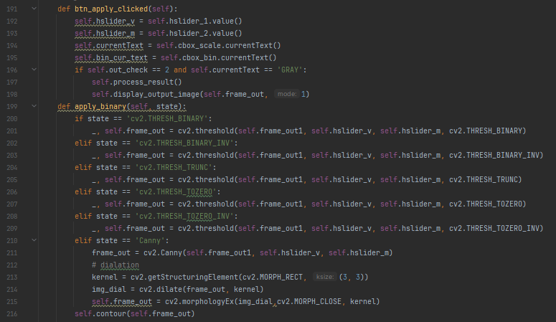
Part 3
코드

Slide 18
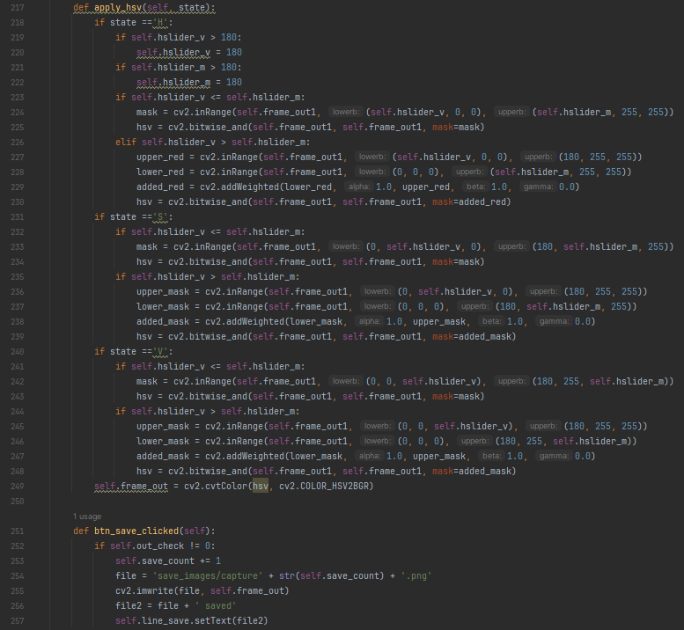
Part 3
코드

Slide 19
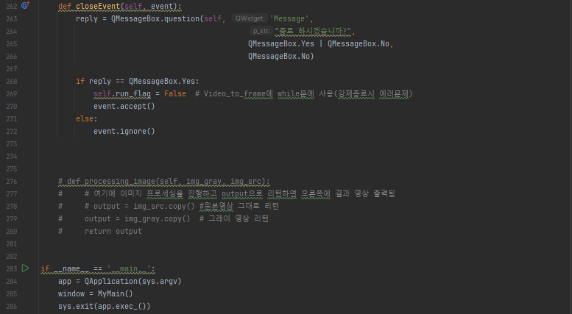
Part 3
코드

Slide 20
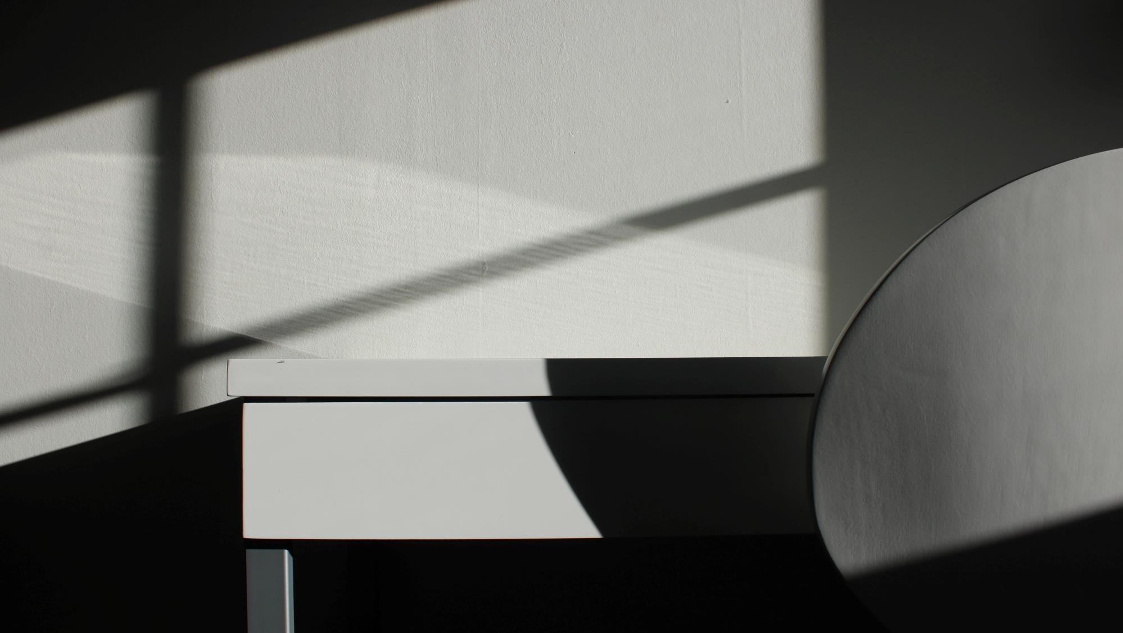
Part 4
개선 사항
ⓒSaebyeol Yu. Saebyeol’s PowerPoint

Slide 21

개선 사항
threshold 및 hsv 색 추출 기능만 보유
기능적 다양성 필요
Hsv 색 추출 시 하나의 채널만 조작 가능
ⓒSaebyeol Yu. Saebyeol’s PowerPoint

Slide 22
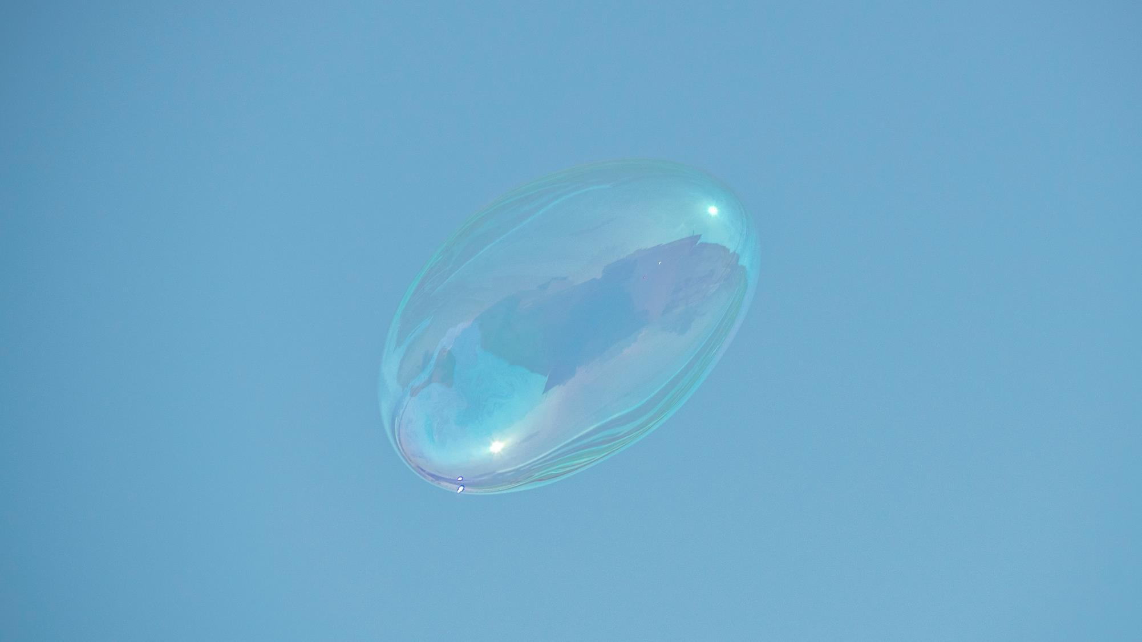
THANK YOU
ⓒSaebyeol Yu. Saebyeol’s PowerPoint

